Slide 1
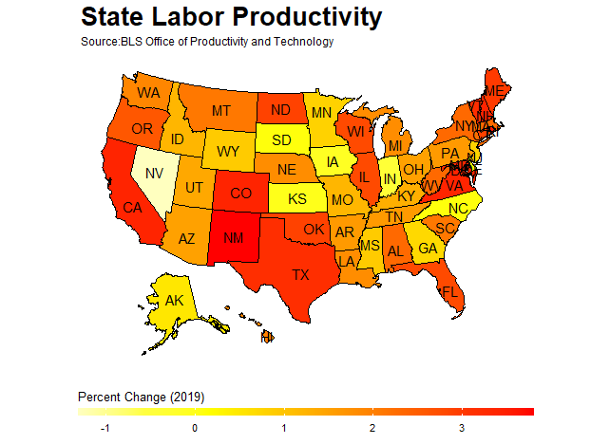
Michael Jadoo
(**Any views expressed by me are my own and not of the BLS**)

Slide 2
Outline
Purpose
The Data
Visualization using R (USMAP)

Slide 3
Purpose
To produce state- level labor productivity measures using currently available data for the public.

Slide 4

Why did we do this study?
**Our data users frequently request state-level productivity data**
Researchers have put together state productivity with limited scope (output-per-worker)
State-level data can be used to study topics such as those examined using cross-country productivity analysis
State by state comparisons

Slide 5
The Task
Produce state labor productivity estimates as an experimental series
Produce a full set of state and regional estimates for private nonfarm business
Labor productivity
Output
Hours worked
And other measures

Slide 6



Data Production Feasibility
Since 2007, CES has produced state-level all employee average weekly hours
QCEW and CES regularly produce employment data by state
GDP by state is produced regularly on an annual basis by the BEA
OPT can produce output-per-hour

Slide 7
Data Sources
Output – real GDP by state (BEA)
Employment –employment (CES) and (QCEW), unincorporated self-employed and unpaid family worker (CPS)
Hours – Average weekly hours paid (CES), HWHP ratios (NCS), unincorporated self-employed and unpaid family worker hours (CPS)
Employee compensation (BEA)

Slide 8
The Data

Slide 9
Output

Slide 10
Statistical Discrepancy
The aggregated state GDP differs from NIPA GDP for two reasons:
Federal civilian and military personnel stationed abroad and fixed capital for military structures located abroad and for military equipment
GDP by state, GDP, and the annual industry accounts have different revision schedules

Slide 11
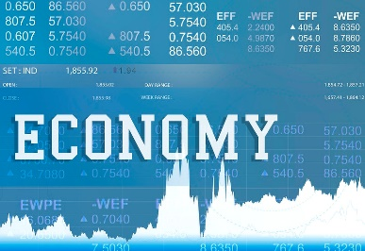


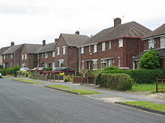
Current Dollar Private Nonfarm
For transparent methodology we created an output measure to match our national output data.
Measured by subtracting current dollar farm industry , private households workers, and owner-occupied housing from private business.
(
-
)
=
-
Farm
Private Household workers
owner-occupied housing
Private Nonfarm
*We measure private sector because the data collected is of a higher quality compared to government or government enterprises which is primarily measured using inputs. Owner-occupied housing and private household data are removed because there are no comparable data on hours

Slide 12
Input

Slide 13
Hours and Employment
Hours worked = [N * AWH * HWHP * 52] + SEUFWhours
N= Total employment QCEW employment , CES employment
AWH = Average weekly hours
HWHP = Hours worked to Hours Paid ratio
SEUFWHours= Self-Employed & Unpaid family workers hours worked- Annual

Slide 14
Wage and Salary Employment and Hours
Employment is based primarily on CES state-level employment series, with supplemental for the agricultural sector using QCEW (N)
CES all employee average weekly hours paid (2007-present) (AWH)
CPS average weekly hours for self-employed and unpaid workers (SEUFWhours)
*Hours worked = [N * AWH * HWHP * 52] + SEUFWhours

Slide 15
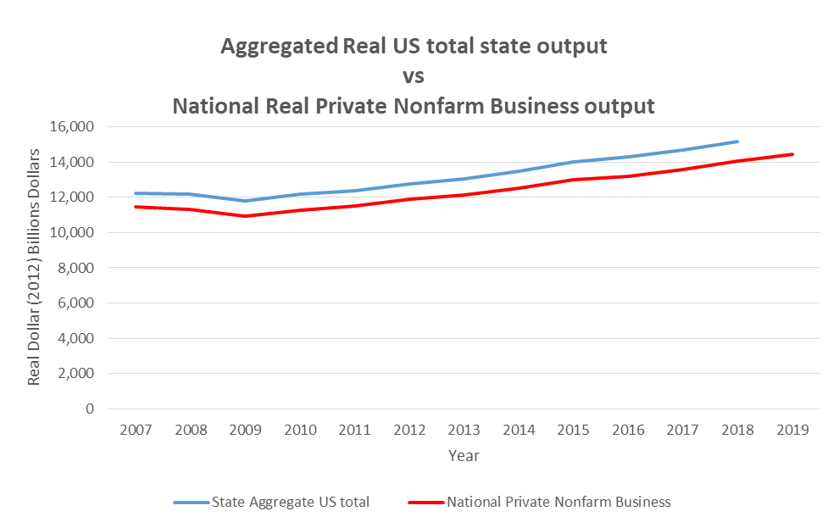
Comparison of state aggregated Output and Hours
* National Private nonfarm output removes nonprofit establishments while the state level data does not.
*The hours comparison used LPC total economy hours that included nonprofits

Slide 16
Data release schedule
Preliminary and annual estimate released on or about June

Slide 17
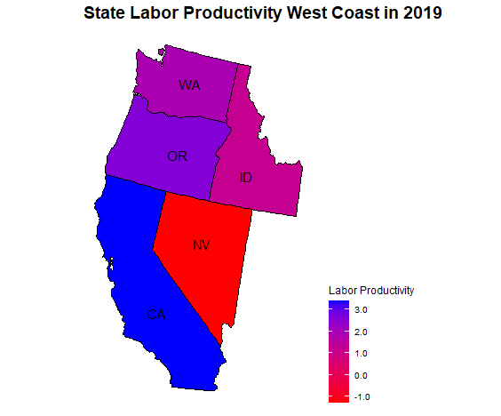

plot_usmap( data = df2, values = "Value", labels=TRUE,include = c("CA", "NV", "ID", "OR", "WA")) +
labs(title = "State Labor Productivity West Coast in 2019") +
scale_fill_continuous( low = "Red", high = "blue",
name = "Labor Productivity", label = scales::comma) +
theme(legend.position = "right")+
theme(plot.title = element_text(size = 14, face = "bold"))

Slide 18
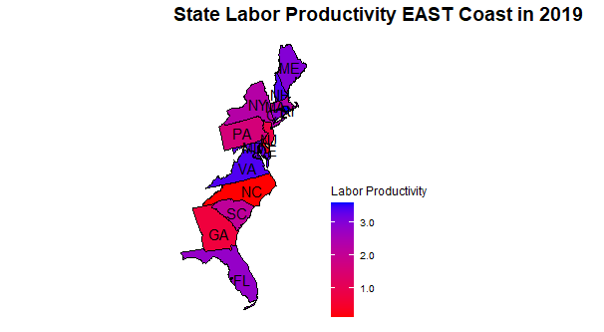
plot_usmap( data = df2, values = "Value", labels=TRUE,include = east) +
labs(title = "State Labor Productivity EAST Coast in 2019") +
scale_fill_continuous( low = "Red", high = "blue",
name = "Labor Productivity", label = scales::comma) +
theme(legend.position = "right")+
theme(plot.title = element_text(size = 14, face = "bold"))

Slide 19
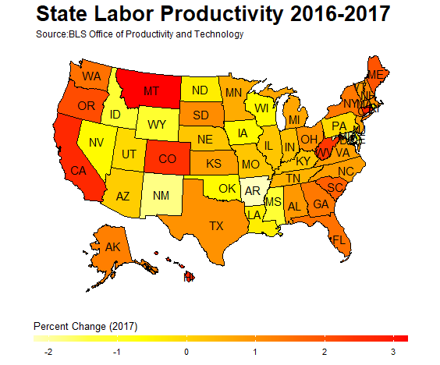

Slide 20
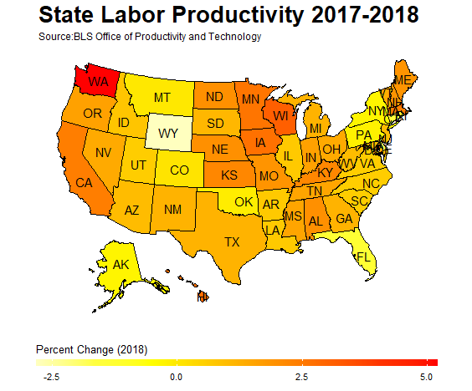

Slide 21
The End
Access our data here: https://www.bls.gov/lpc/state-productivity.htm

